Slide 1
CS 6610 Interactive computer graphics final project
Physics based Rendering: Disney principle, texture, material, light, camera
Zhongyi Jiang & Yongfeng Qiu

Slide 2
What we did
Physics Based Camera: Shutter speed, aperture, sensitivity
Disney principle PBR (10 parameters)
Material: Picture Textures, Procedural Texture (Noise),
Lights: theory light (point, spot, directional), Image based light, area light
Texture: Picture Texture, skybox
User Interface: camera, light, tessellation level, displacement factor

Slide 3
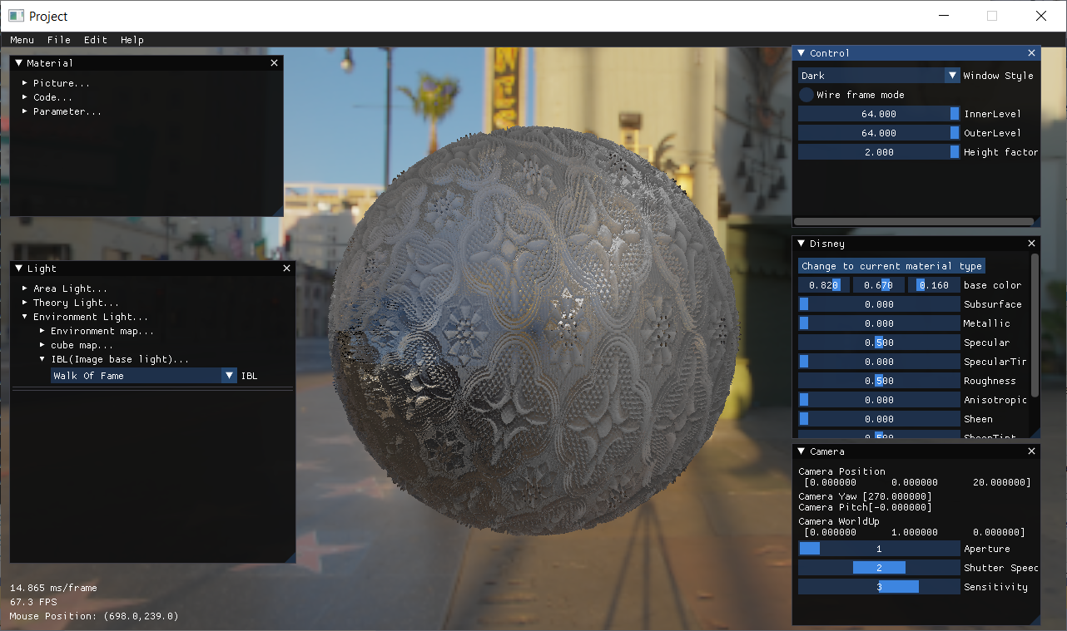
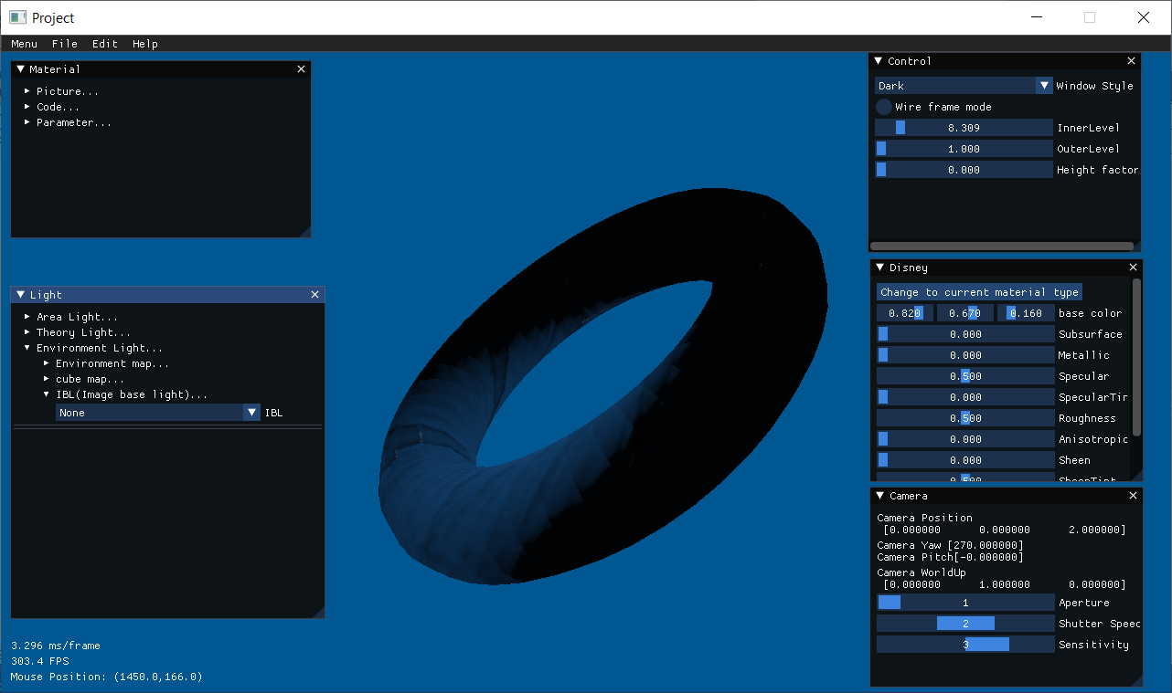
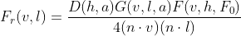
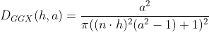
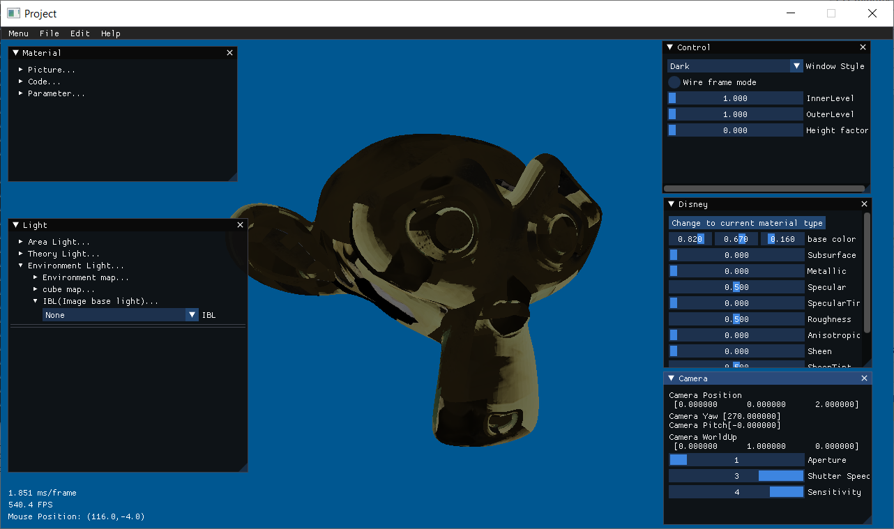
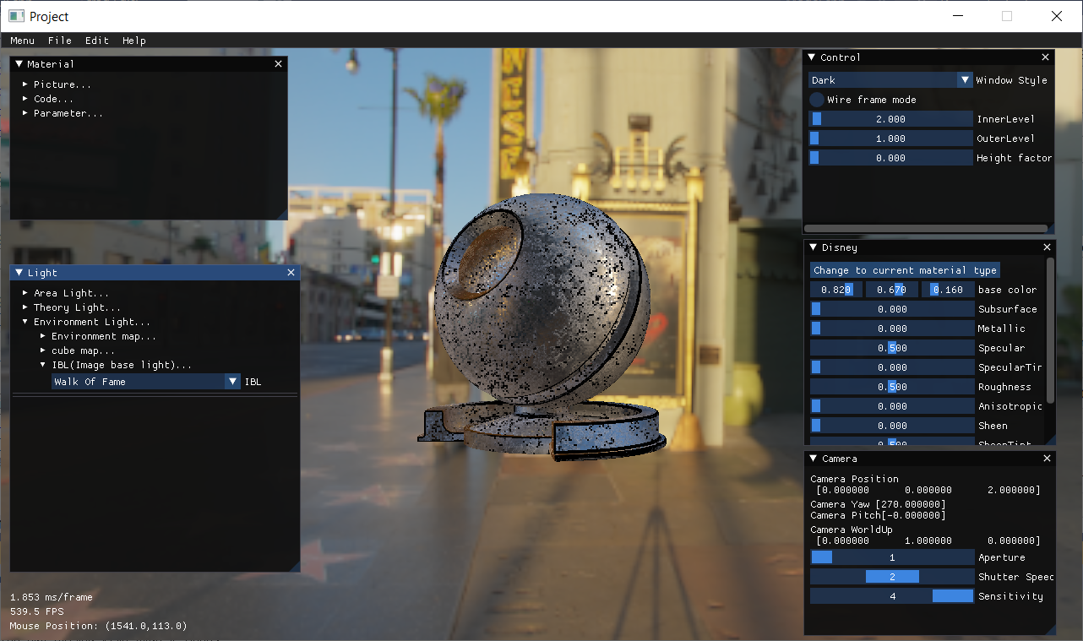
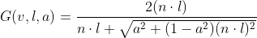
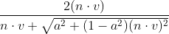
PICTURE TEXTURE
Cook-Torrance

Slide 4
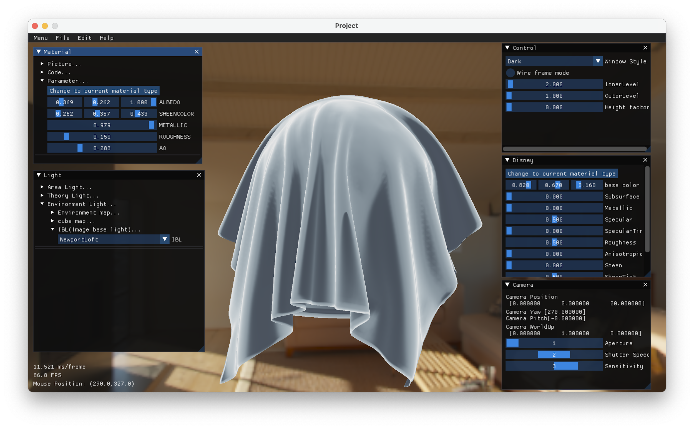
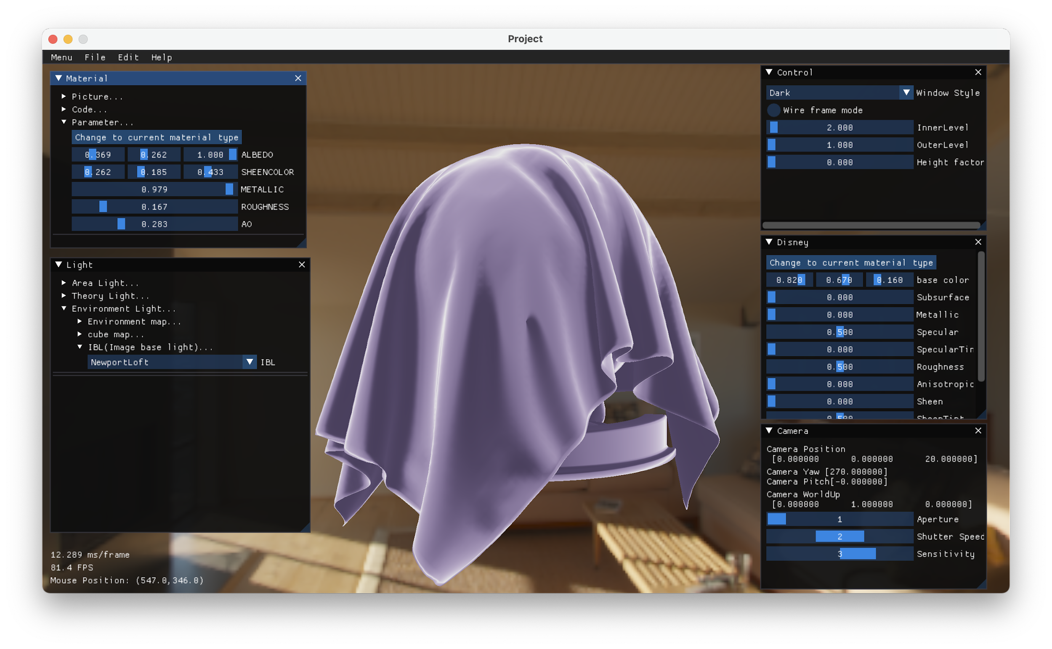
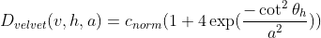
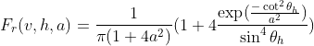
Procedural Texture： five parameters in this cloth textures

Slide 5
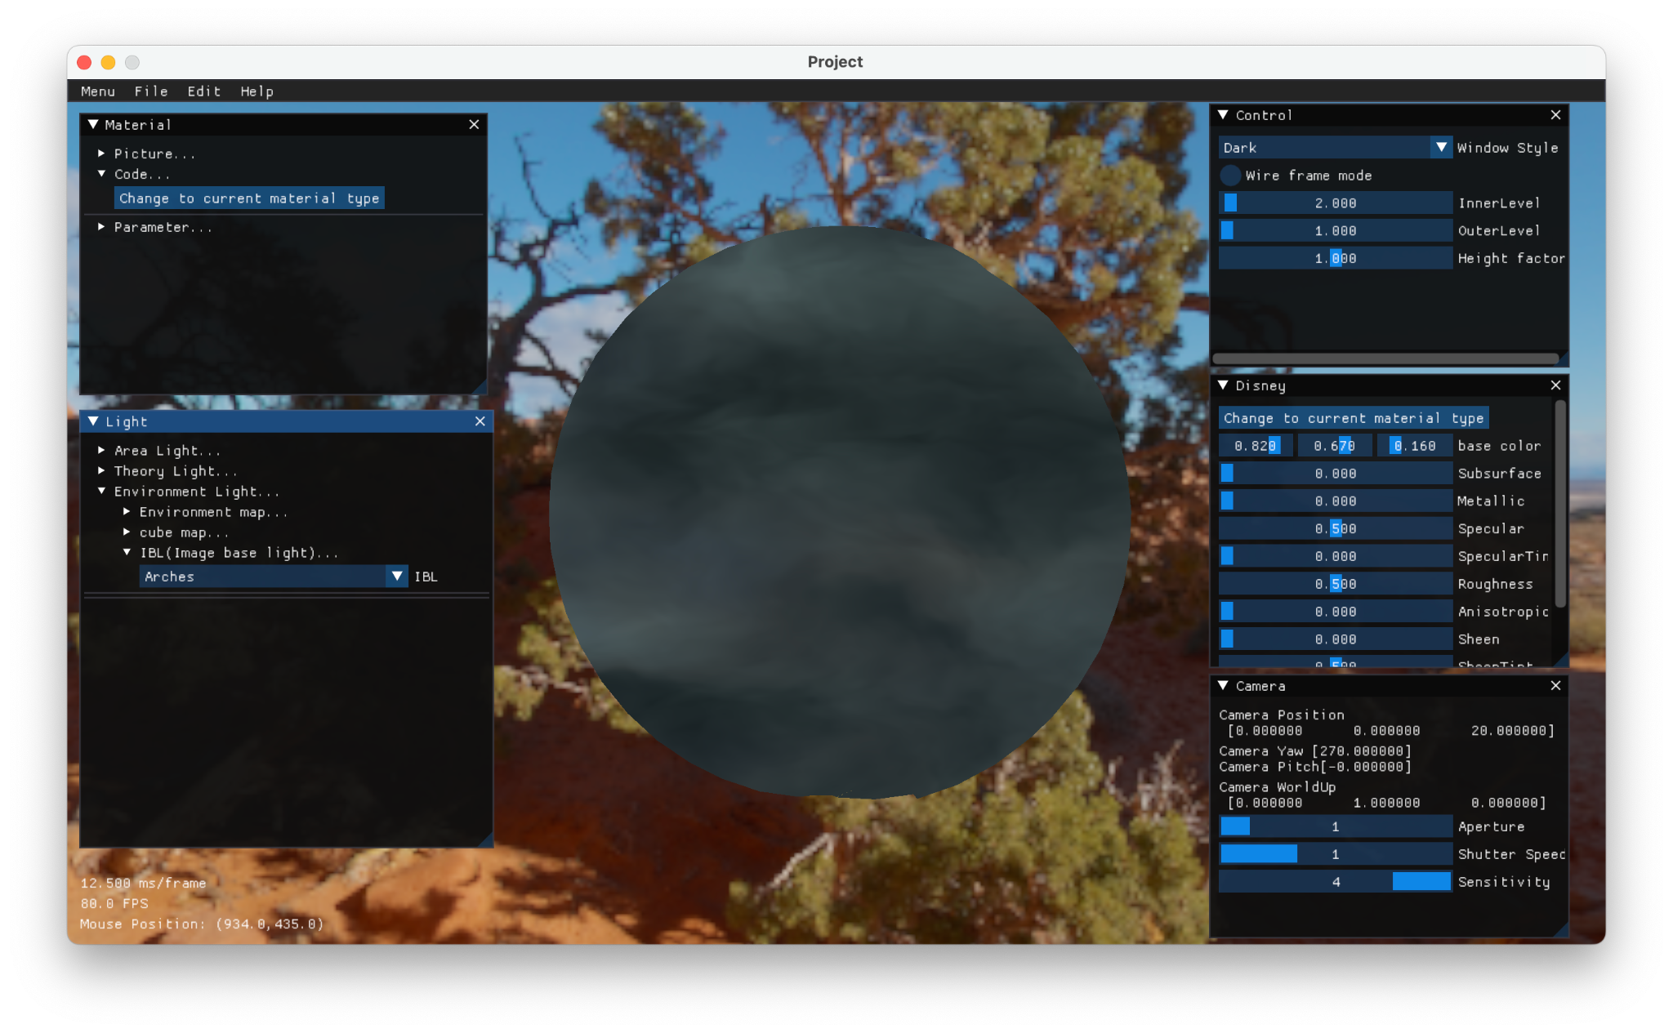
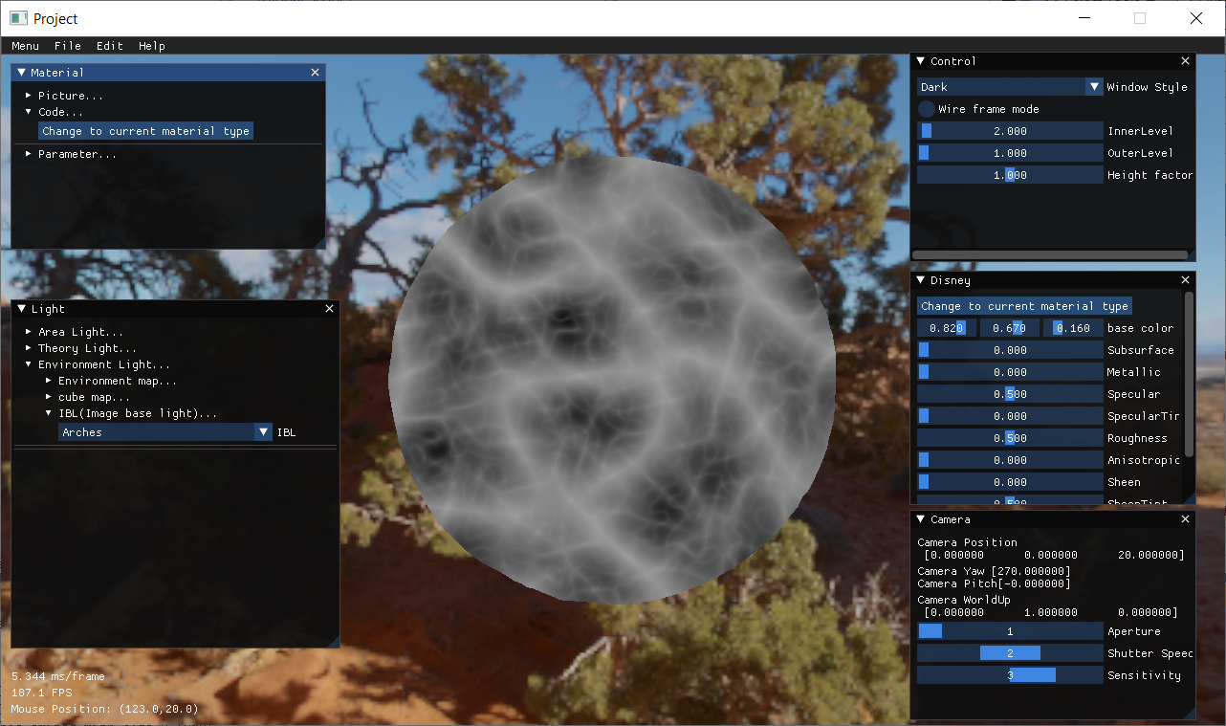
Procedural Texture : Cloud and lightning

Slide 6
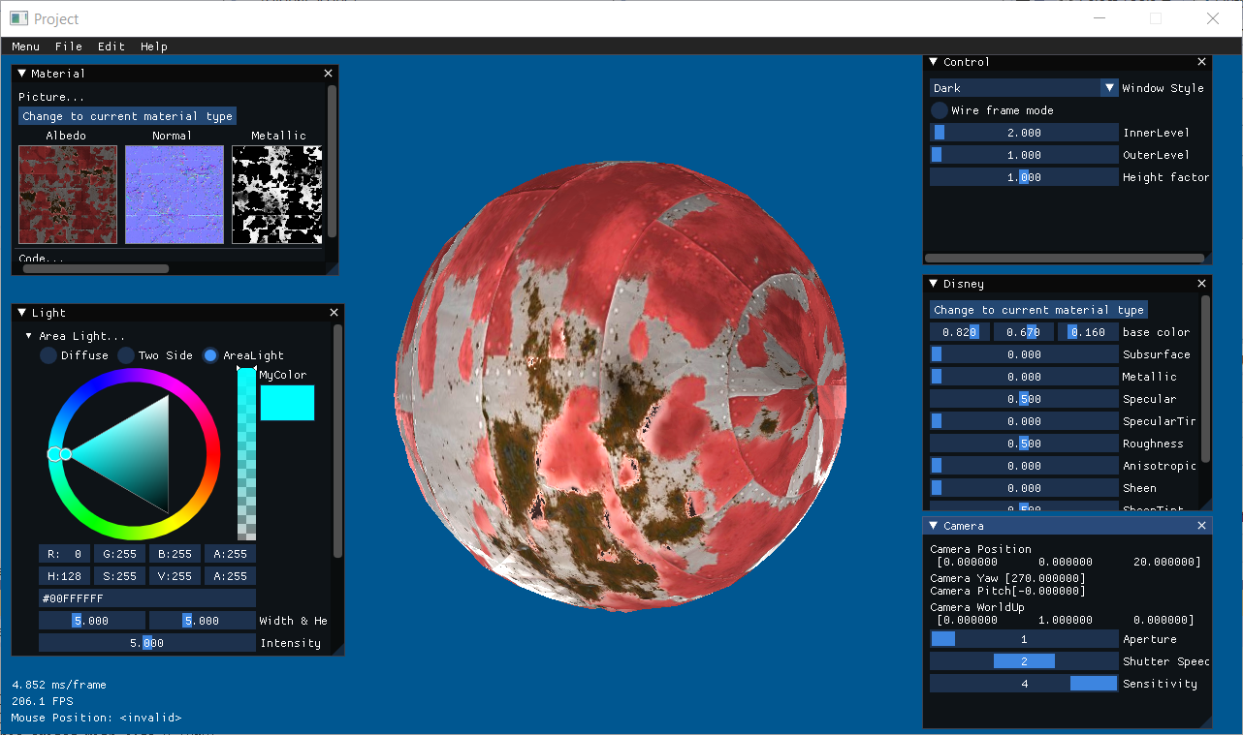
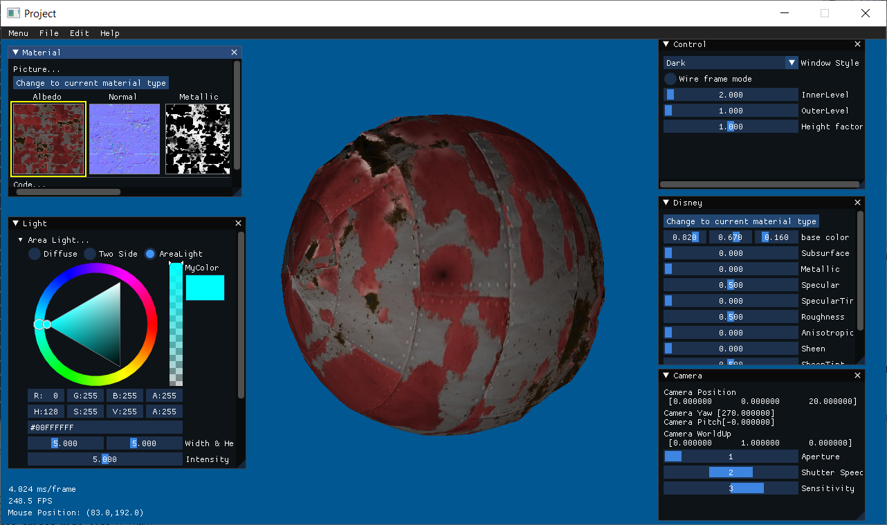
Physics based camera: different sensitivity
Aperture: controls how open or closed the camera systems aperture
Shutter speed: controls how long the aperture remains open
Sensitivity: controls how the light reaching the sensor is quantized.

Slide 7
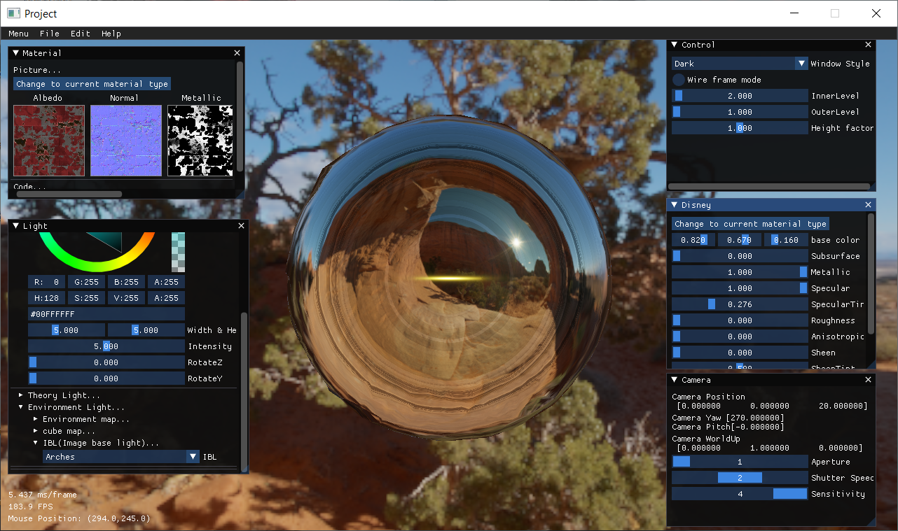
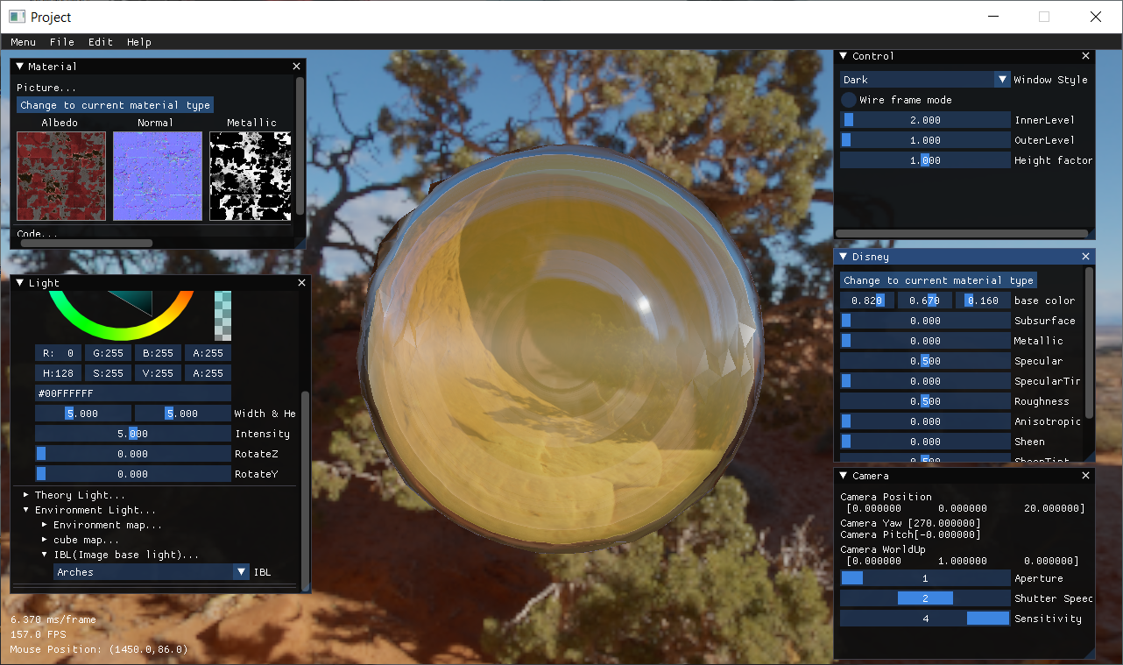
Disney principle, using image based light
10 parameters: roughness, shin, etc.
Diffusse BRDF Lambertian－》Burley

Slide 8
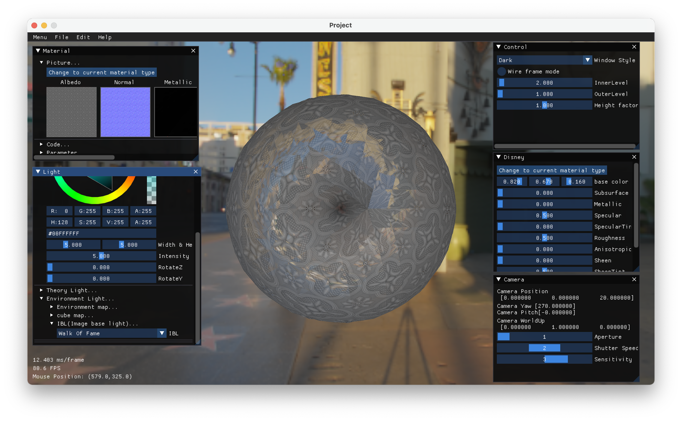
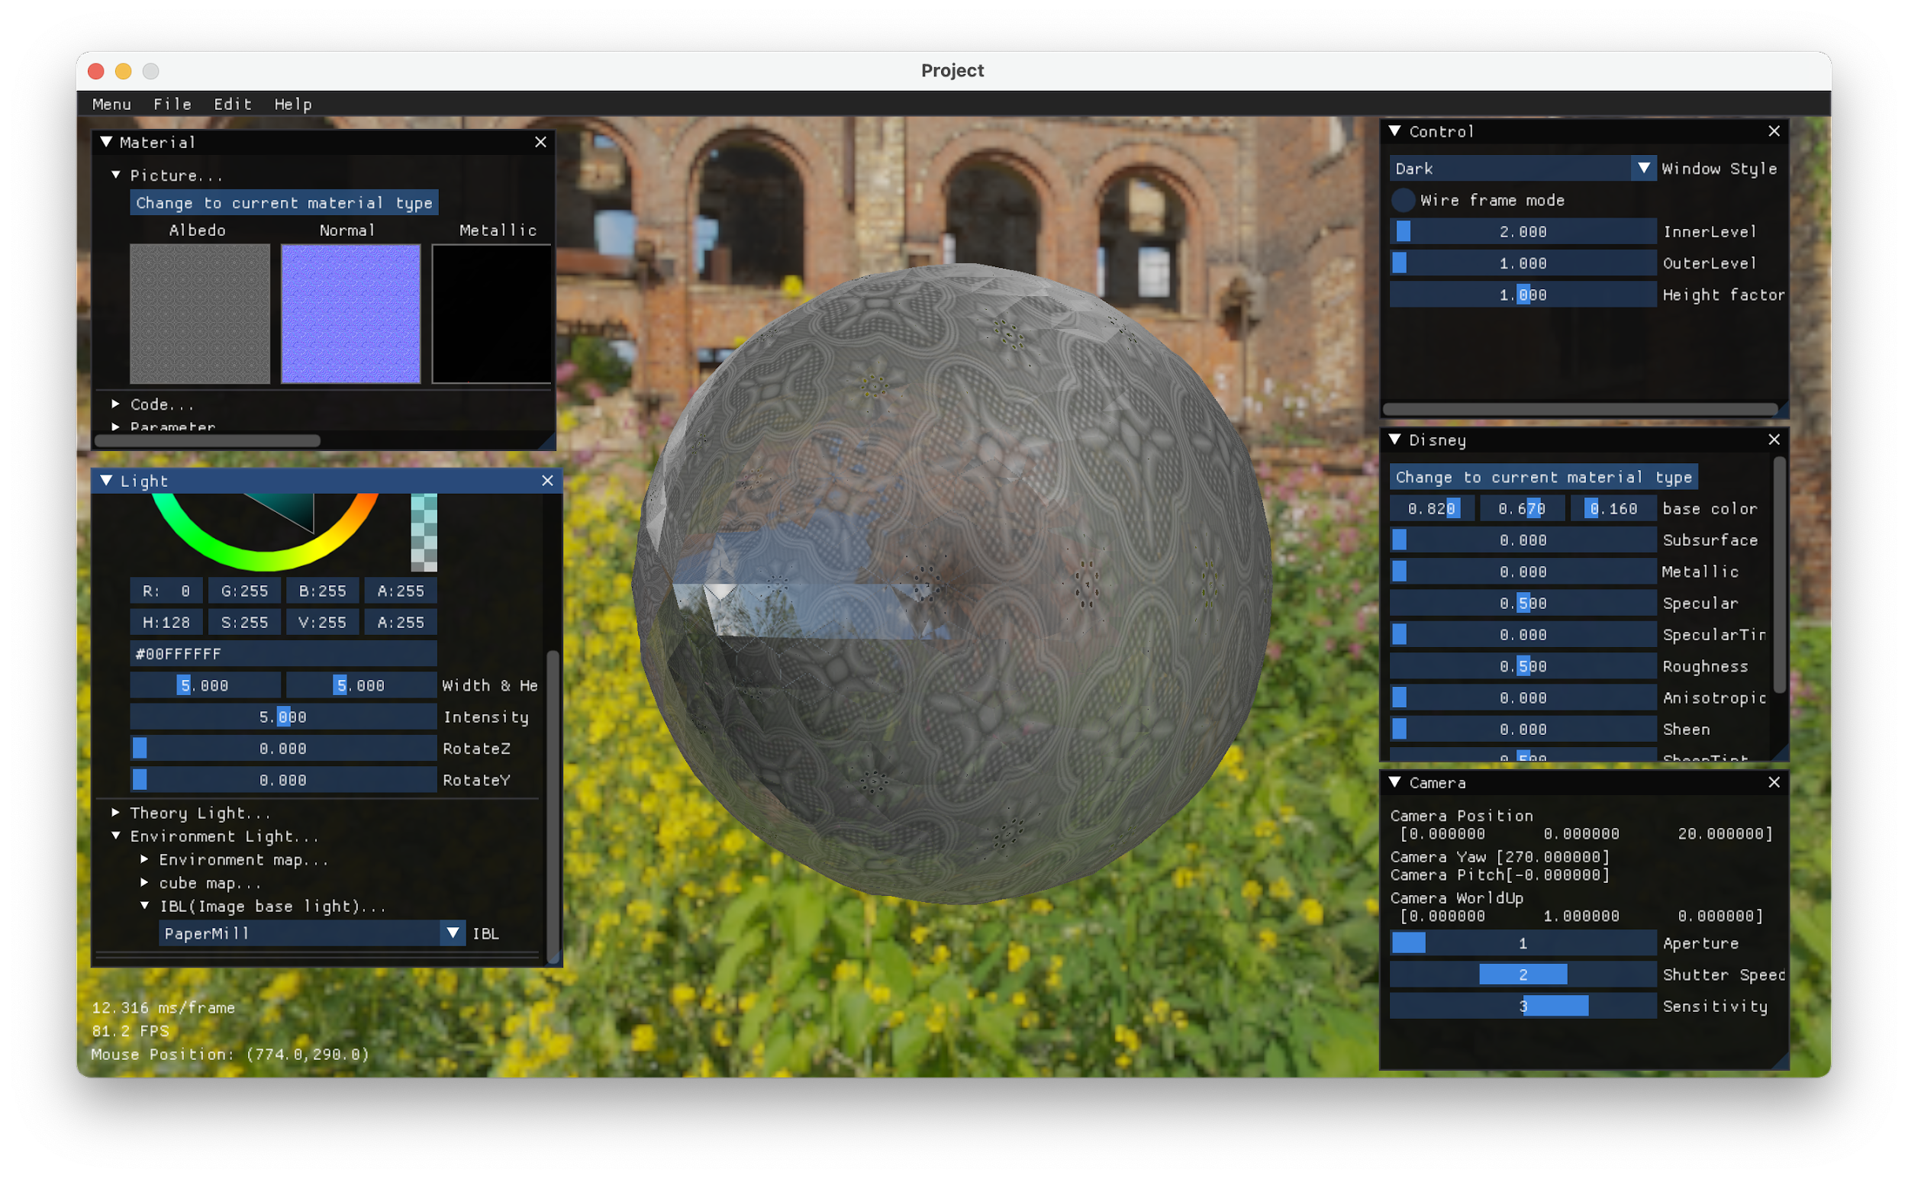
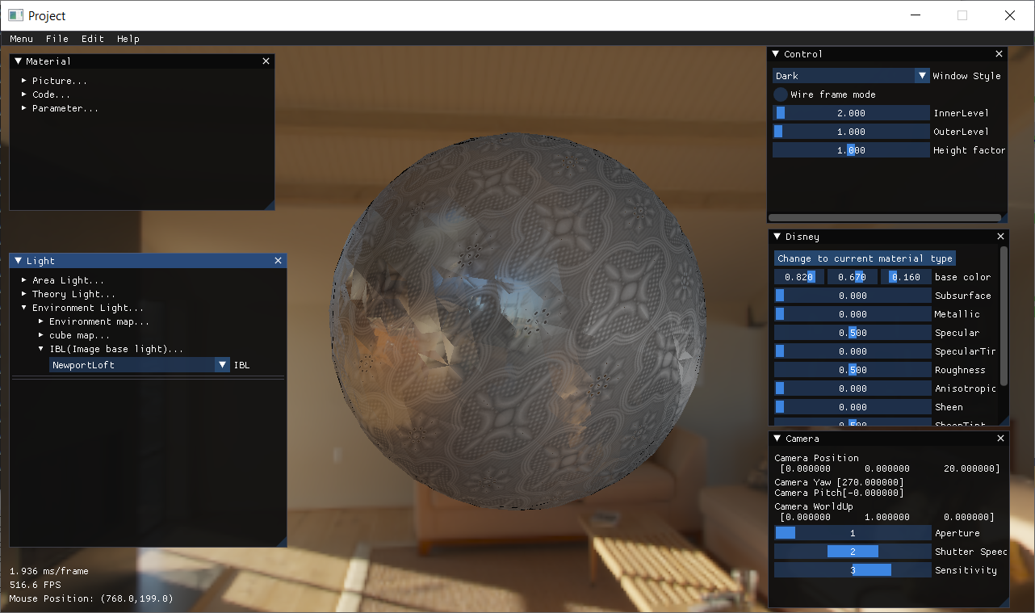
Image Based Lighting

Slide 9
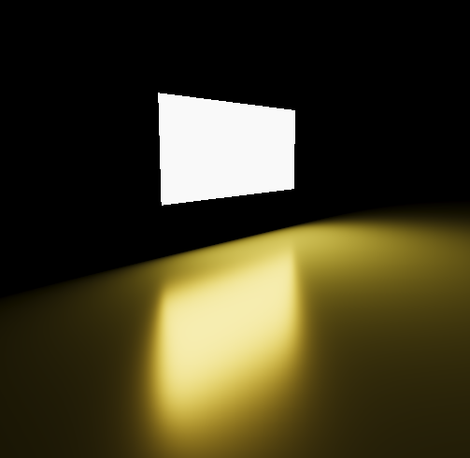
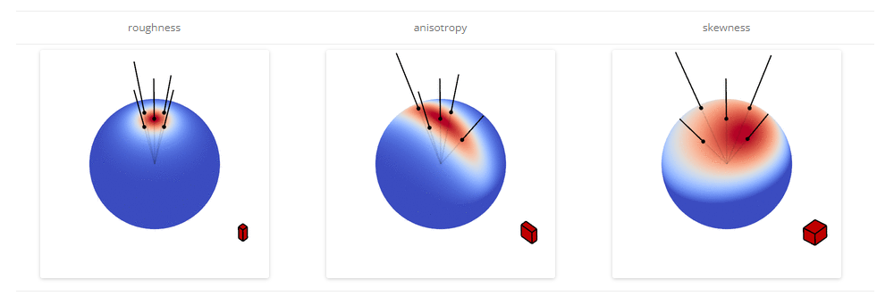
Physics Based area light example
Use Linearly transformation cosines to find out integral analytic solution.

Slide 10
Live Demo!

